Slide 1
Diversity
Diversity
Diversity
Diversity
TCH 347 Social Studies Methods
Shippensburg University
Han Liu

Slide 2
Traits of Diversity
Race
Ethnicity
National Origin
Culture
Religion
Sex or sexual orientation
Marital status
Age
Political beliefs
Socioeconomic status
Disabling conditions
Vocational interests
From Pennsylvania’s Code of professional Practice and Conduct for Educators

Slide 3
Traits of Diversity
Ethnicity
Race
Socioeconomic status
Gender
Exceptionalities
Language
Religion
Sexual orientation
Geographic area
From the Conceptual Framework Standards of the College of Education

Slide 4
Create Supportive Educational Environments
Demonstrate understanding of the differences in how students learn and know how to accommodate diversity
Accommodate diverse learning needs through informed decision-making that supports academic success for all students
Show respect for the diverse needs and talents of all learners and demonstrate commitment to helping them develop self-efficacy and achieve academic success

Slide 5
Melting Pot

Slide 6
Melting Pot

Slide 7
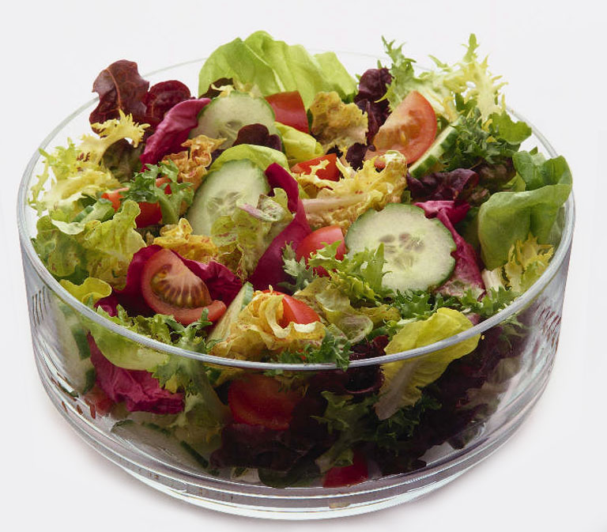
Salad

Slide 8
Salad

Slide 9
Mosaic

Slide 10
Mosaic

Slide 11
American Culture
American Identity

