Slide 1
7.1 Introduction to Graph Theory
MAT 225 Discrete Math

Slide 2
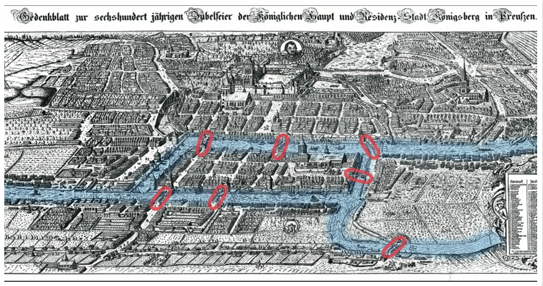
The Seven Bridges of Köninsberg

Slide 3
Graph
vertices
edges
vertex

Slide 4
Definitions
A walk is in a graph is an alternating sequence of vertices and edges which begins and ends with a vertex, and each edge in the sequence is between its endpoints.
A trail is a walk with no repeated edges. A circuit is a trail starting and ending at the same vertex.
A trail (or circuit) that uses every edge in a graph is called Eulerian.

Slide 5
Questions
Does the graph representing the seven bridges of Köninsberg have a Eulerian trail?
In general, how do we determine if a graph has a Eulerian circuit or Eulerian trail?

Slide 6
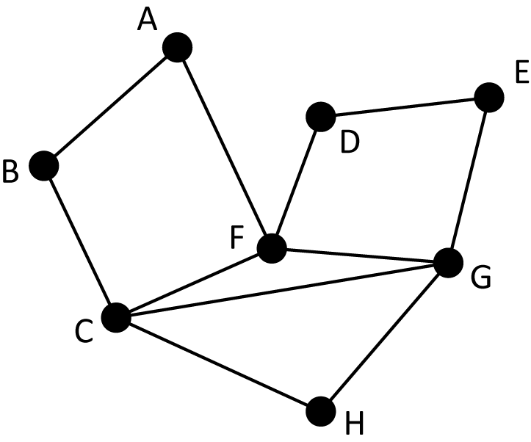
When does a graph have an Eulerian circuit?
This graph does not have a Eulerian circuit.
This graph does have an Eulerian circuit.

Slide 7
When does a graph have a Eulerian circuit?
How could I convince you that this graph has an Eulerian circuit?
I can show it to you!
This graph does have an Eulerian circuit.

Slide 8
Finding the Eulerian Circuit

Slide 9
Finding the Eulerian Circuit

Slide 10
Finding the Eulerian Circuit

Slide 11
Finding the Eulerian Circuit

Slide 12
Finding the Eulerian Circuit

Slide 13
Finding the Eulerian Circuit

Slide 14
Finding the Eulerian Circuit

Slide 15
Finding the Eulerian Circuit

Slide 16
Finding the Eulerian Circuit

Slide 17
Finding the Eulerian Circuit

Slide 18
Finding the Eulerian Circuit

Slide 19
Finding the Eulerian Circuit

Slide 20
Why does a graph have a Eulerian circuit (or not)?
Why does this graph not have a Eulerian circuit?
Why does this graph have a Eulerian circuit?

Slide 21
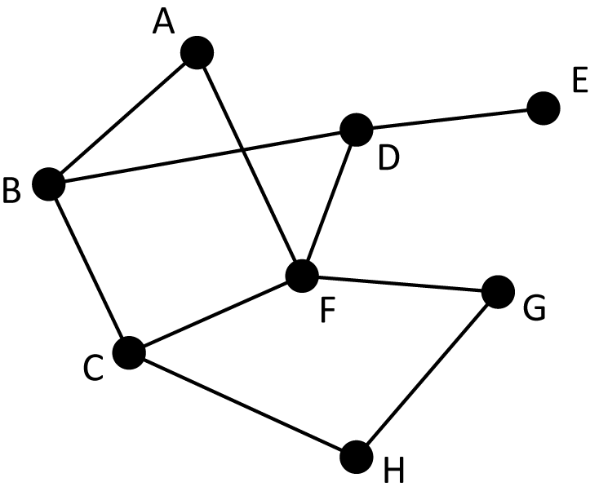
Degree
The degree of a vertex is the number of edges that meet at that vertex

Slide 22
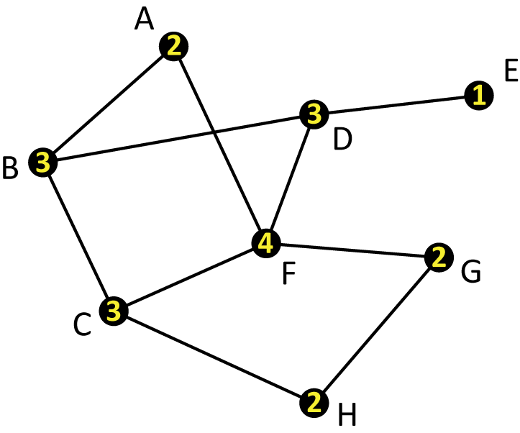
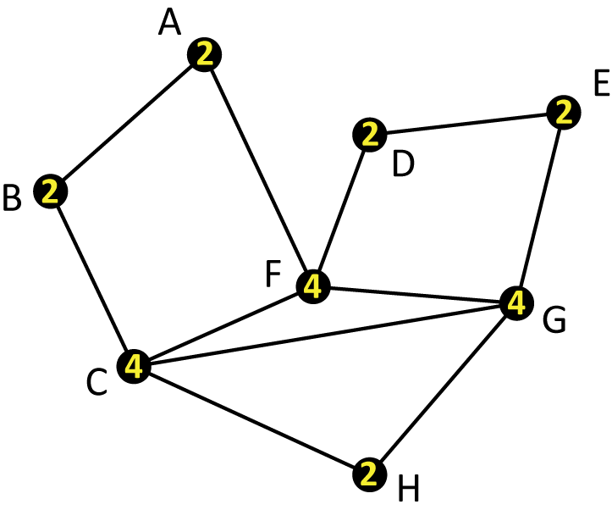
Degree
The degree of a vertex is the number of edges that meet at that vertex

Slide 23
Degree
The degree of a vertex is the number of edges that meet at that vertex
For example, in this graph, the degree of C is 4 because there are four edges (to B, to F, to G, and to H) that meet there

Slide 24
What does degree have to do with Eulerian circuits?
You might be able to tell right away that this graph can’t possibly have an Eulerian circuit
Why not?

Slide 25
What does degree have to do with Eulerian circuits?
If a graph has a vertex with degree 1, the graph cannot have an Eulerian circuit
If we start at E, we will never be able to return to E without retracing
If we don’t start at E, when we go there we cannot leave without retracing.

Slide 26
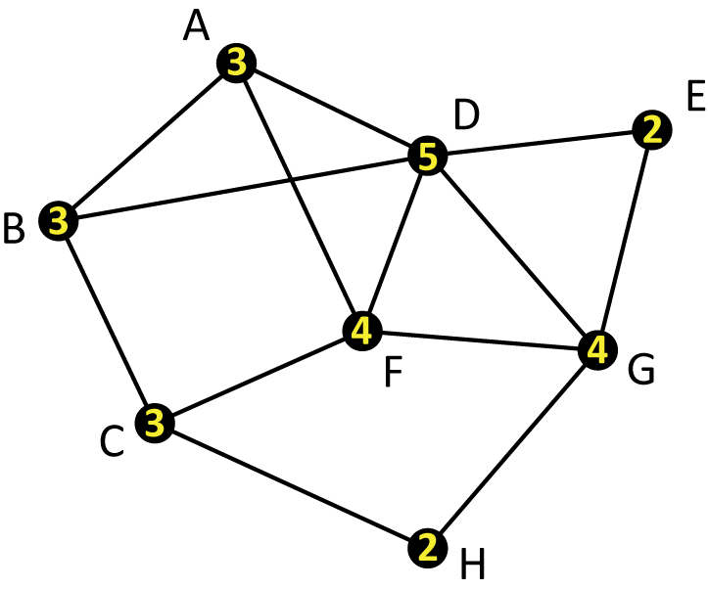
What does degree have to do with Eulerian circuits?
The problem isn’t just degree 1
This graph also doesn’t have an Eulerian circuit
The problem is that some of the degrees are odd numbers

Slide 27
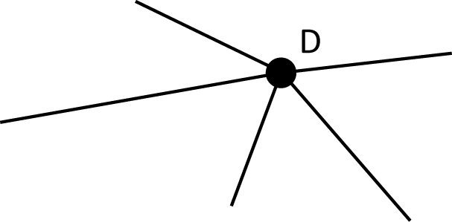
What does degree have to do with Eulerian circuits?
Let’s focus on vertex D, which has degree 5
Suppose we start elsewhere in the graph

Slide 28
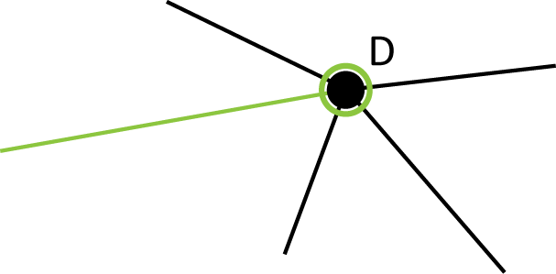
What does degree have to do with Eulerian circuits?
Since we want to cover all edges, we’ll have to visit D eventually

Slide 29
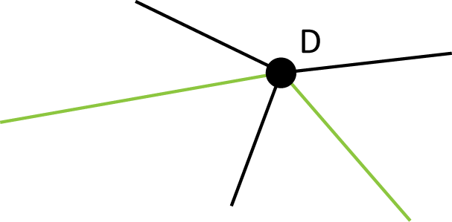
What does degree have to do with Eulerian circuits?
We have several unused edges, so we need to follow one of them and leave D

Slide 30
What does degree have to do with Eulerian circuits?
In fact, every time we visit a vertex, we will “use up” two of the edges that meet at that vertex

Slide 31
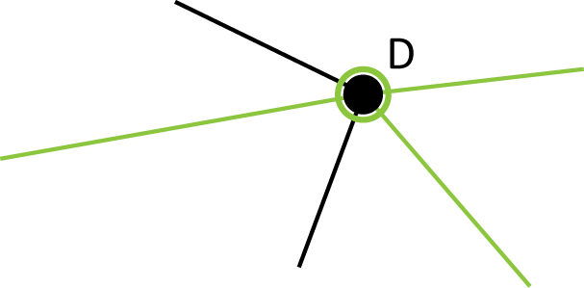
What does degree have to do with Eulerian circuits?
We have unused edges, so we need to visit D again at some point…

Slide 32
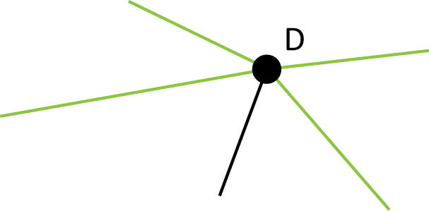
What does degree have to do with Eulerian circuits?
…and then leave again…

Slide 33
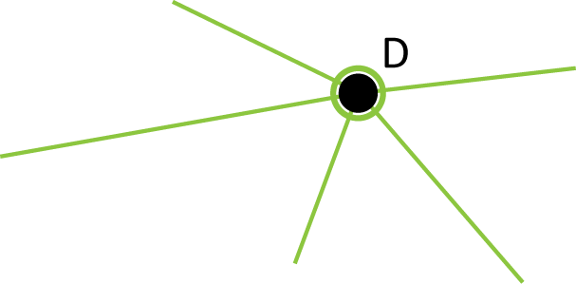
What does degree have to do with Eulerian circuits?
…and then come back again.
But now we’re stuck, since we can’t leave D without retracing, but D wasn’t our starting point.

Slide 34
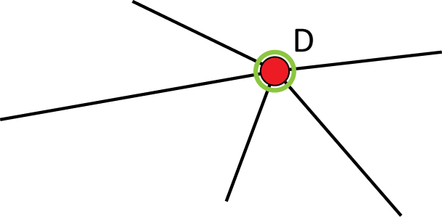
What does degree have to do with Eulerian circuits?
What if we had started at D?

Slide 35
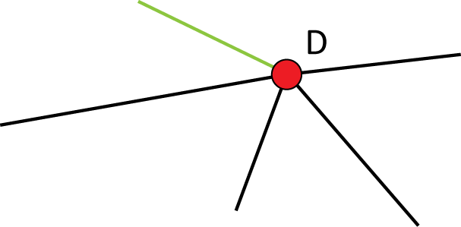
What does degree have to do with Eulerian circuits?
First, we need to leave D…

Slide 36
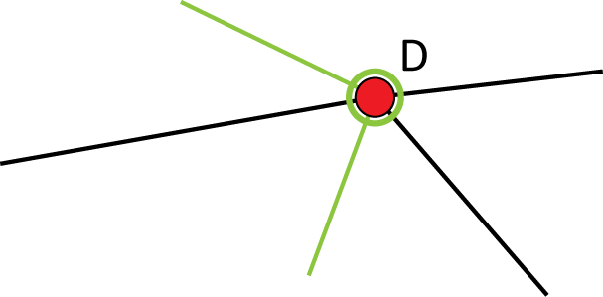
What does degree have to do with Eulerian circuits?
… then sometime later, we have to come back to D…

Slide 37
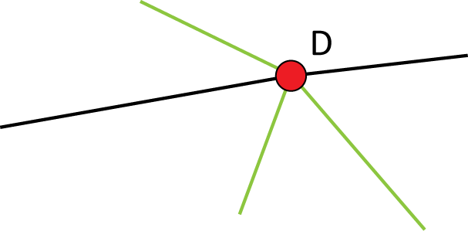
What does degree have to do with Eulerian circuits?
… and then leave again …

Slide 38
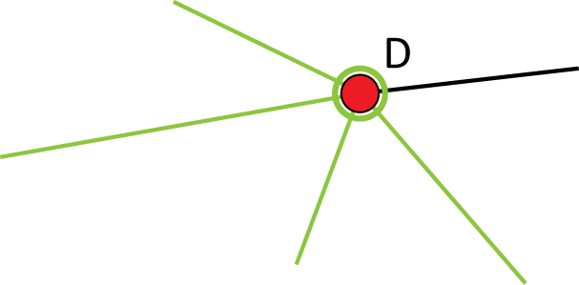
What does degree have to do with Eulerian circuits?
… and then come back again …

Slide 39
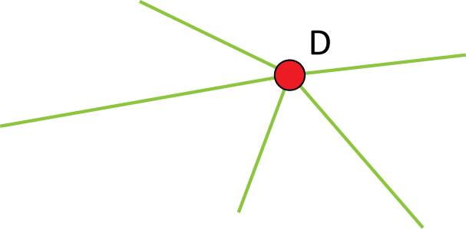
What does degree have to do with Eulerian circuits?
… and then leave again.
But D was our starting point, and we have run out of edges to use to come back to D!

Slide 40
No Eulerian Circuits With Odd Degrees
If a graph has any vertex with an odd degree, then the graph does not have an Eulerian circuit
The reverse is true as well

Slide 41
Theorem 2 (in section 7.1)
A graph G has a Eulerian circuit if and only if every vertex has an even degree.

Slide 42
Theorem 5 (in section 7.1)
A graph G has a Eulerian trail if and only if G has exactly two vertices with odd degree. Moreover, the trail must begin and end at these two vertices.

