Slide 1
Discrete Mathematics Section 1.1
First Examples

Slide 2
A Magic Trick

Slide 3
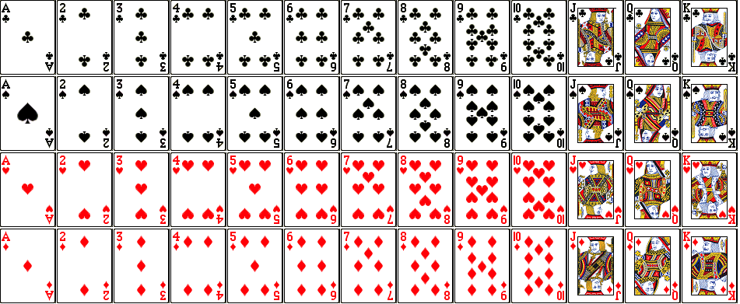
A Deck of Playing Cards

Slide 4
A Deck of Playing Cards

Slide 5
Turn the spade (the uppermost card) face down

Slide 6
Move any number of cards, one at a time, from the top of the packet to the bottom

Slide 7
Turn over the top two cards as one

Slide 8
Move any number of cards, one at a time, from the top of the packet to the bottom

Slide 9
Turn over the top two cards as one

Slide 10
Move any number of cards, one at a time, from the top of the packet to the bottom

Slide 11
Either turn over the entire stack or do not – your choice

Slide 12
Turn over the topmost card

Slide 13
Turn over the top two cards as one

Slide 14
Turn over the top three cards as one

Slide 15
Close your eyes and say, “I do believe in magic!”

Slide 16
The club ( ) is the only card facing the opposite way from the others!

Slide 17
Turn the spade (the uppermost card) face down

Slide 18
Move any number of cards, one at a time, from the top of the packet to the bottom

Slide 19
Turn over the top two cards as one

Slide 20
Move any number of cards, one at a time, from the top of the packet to the bottom

Slide 21
Turn over the top two cards as one

Slide 22
Move any number of cards, one at a time, from the top of the packet to the bottom

Slide 23
Either turn over the entire stack or do not – your choice

Slide 24
Turn over the topmost card

Slide 25
Turn over the top two cards as one

Slide 26
Turn over the top three cards as one

Slide 27
Close your eyes and say, “I do believe in magic!”

Slide 28
The club ( ) is the only card facing the opposite way from the others!

Slide 29
The Ten Steps
Turn the spade (the uppermost card) face down
Move any number of cards, one at a time, from the top of the packet to the bottom
Turn over the top two cards as one
Move any number of cards, one at a time, from the top of the packet to the bottom
Turn over the top two cards as one
Move any number of cards, one at a time, from the top of the packet to the bottom
Either turn over the entire stack or do not – your choice
Turn over the topmost card
Turn over the top two cards as one
Turn over the top three cards as one

Slide 30
The Ten Steps
Turn the spade (the uppermost card) face down
Move any number of cards, one at a time, from the top of the packet to the bottom
Turn over the top two cards as one
Move any number of cards, one at a time, from the top of the packet to the bottom
Turn over the top two cards as one
Move any number of cards, one at a time, from the top of the packet to the bottom
Either turn over the entire stack or do not – your choice
Turn over the topmost card
Turn over the top two cards as one
Turn over the top three cards as one

Slide 31
A Matter of Life and Death

Slide 32
Flavius Josephus
In the Jewish revolt against Rome, Josephus and 39 of his comrades were holding out against the Romans in a cave. With defeat imminent, they decided to commit mass suicide. They arranged themselves in a circle. One man was designated as number one, and they proceeded clockwise killing every seventh man . . .

Slide 33
Flavius Josephus
In the Jewish revolt against Rome, Josephus and 39 of his comrades were holding out against the Romans in a cave. With defeat imminent, they decided to commit mass suicide. They arranged themselves in a circle. One man was designated as number one, and they proceeded clockwise killing every seventh man . . .
Josephus figured out where to sit in order to be the last to go. When the time came, he surrendered to the Romans as the sole survivor and eventually joined the Roman side.

Slide 34
It’s Just a game

Slide 35
Tennis Example 1
In a certain tennis league, the first player to win two sets wins the match. Suppose Player A has a 55% chance of winning a set against Player B.
What is the probability that Player A wins the match?
If these two players played many matches, what would you expect to be the average number of sets that determine a match?

Slide 36
Tennis Example 2
In tennis, each player’s score progresses from 0 to 15 to 30 to 40 to game with one catch: A score of 40-40 is called a “deuce,” and the game can only be won if a player wins by two consecutive points. Suppose that player A has a 60% chance of winning a point against Player B.
What is the probability that Player A wins the game?
If these two player played many games, what would you expect to be the average number of points that determine a game?

Slide 37
An elementary puzzle

Slide 38
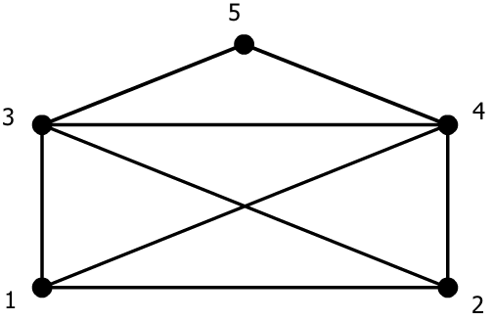
Example 1

