Slide 1
Introduction to Probability
Discrete Mathematics

Slide 2
Tossing Two Coins
When we toss two coins, the number of heads that turns up can be 0, 1, or 2.
What is the chance you will get 1?

Slide 3
Tossing Two Coins
When we toss two coins, the number of heads that turns up can be 0, 1, or 2.
What is the chance you will get 1?
You might be thinking it is 1/3. If you are, then you are incorrect. But why?

Slide 4
You Are Not Alone!
Read about Jean Le Rond d’Alembert’s legacy on Wikipedia, and learn how a mathematician writing about probability made the same mistake.
In fact, trying to determine how likely something is to happen causes mathematicians, lawyers, doctors, and everybody else all kinds of trouble.

Slide 5
So What’s the Problem Here?
The problem lies in the meaning of the term outcomes, and how the chance of something happening can be computed from the possible outcomes.

Slide 6
So What’s the Problem Here?
The problem lies in the meaning of the term outcomes, and how the chance of something happening can be computed from the possible outcomes.
Let’s not focus on the number of heads that can turn up, but instead consider a different set of outcomes.

Slide 7
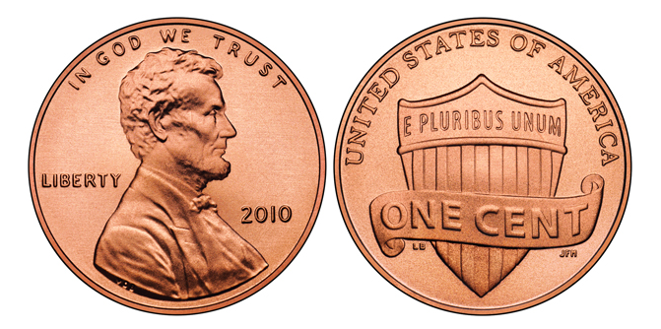
What Goes Up Must Come Down
The key is realizing that how the two coins land can yield the the answer.

Slide 8
What Goes Up Must Come Down
The chance of getting the number of heads to be 1 is 2/4 = 1/2 or 50%.

Slide 9
She’s Having a . . . Twins!
Try this one:
Suppose a mother carrying fraternal (not identical) twins and wants to know the odds of having at least one girl.

Slide 10
She’s Having a . . . Twins!
Try this one:
Suppose a mother carrying fraternal (not identical) twins and wants to know the odds of having at least one girl.
Consider these possible outcomes:

Slide 11
She’s Having a . . . Twins!
Try this one:
Suppose a mother carrying fraternal (not identical) twins and wants to know the odds of having at least one girl.
The odds are 3 in 4, or 75%.

Slide 12
Outcomes and Chance Experiments
An outcome is a result of an activity (procedure, process, etc.).
A chance experiment is an activity with two or more possible outcomes, and we are uncertain which outcome will occur. For example,
Flipping a coin
Rolling a six-sided die
Flipping the arrow of a spinner

Slide 13
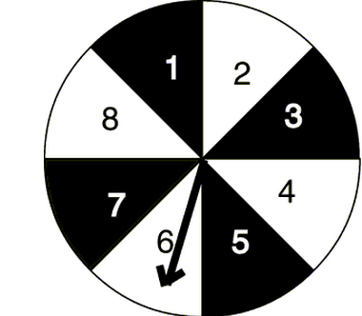
Definition of Sample Space
The sample space of a chance experiment is the set of all the outcomes that could result when the experiment is performed.

Slide 14
Definition of Sample Space
The sample space of a chance experiment is the set of all the outcomes that could result when the experiment is performed.
Chance Exp. Flip spinner, see number it lands on. Sample Space: S = ?

Slide 15
Definition of Sample Space
The sample space of a chance experiment is the set of all the outcomes that could result when the experiment is performed.
Chance Exp. Flip spinner, see number it lands on. Sample Space: S = {1, 2, 3, 4, 5, 6, 7, 8}

Slide 16
Definition of Sample Space
The sample space of a chance experiment is the set of all the outcomes that could result when the experiment is performed.
Chance Exp. Flip spinner, see color it lands on. Sample Space: S = ?

Slide 17
Definition of Sample Space
The sample space of a chance experiment is the set of all the outcomes that could result when the experiment is performed.
Chance Exp. Flip spinner, see color it lands on. Sample Space: S = {black, white}

Slide 18
More Sample Space Examples
Chance Exp. Flip a coin and observe how it lands Sample Space = ?

Slide 19
More Sample Space Examples
Chance Exp. Flip a coin and observe how it lands Sample Space = {H, T}

Slide 20
More Sample Space Examples
Chance Exp. Flip a coin and observe how it lands Sample Space = {H, T}
Chance Exp. Flip two coins and see how they land Sample Space = ?

Slide 21
More Sample Space Examples
Chance Exp. Flip a coin and observe how it lands Sample Space = {H, T}
Chance Exp. Flip two coins and see how they land Sample Space = {HH, HT, TH, TT}

Slide 22
More Sample Space Examples
Chance Exp. Flip a coin and observe how it lands Sample Space = {H, T}
Chance Exp. Flip two coins and see how they land Sample Space = {HH, HT, TH, TT}
Chance Exp. Flip two coins, count number of heads Sample Space = ?

Slide 23
More Sample Space Examples
Chance Exp. Flip a coin and observe how it lands Sample Space = {H, T}
Chance Exp. Flip two coins and see how they land Sample Space = {HH, HT, TH, TT}
Chance Exp. Flip two coins, count number of heads Sample Space = {0, 1, 2}

Slide 24
The Big Question
Chance Exp. Flip two coins and see how they land Sample Space = {HH, HT, TH, TT} The chance of getting heads once is 2/4 or 50%. Why is this correct?

Slide 25
The Big Question
Chance Exp. Flip two coins and see how they land Sample Space = {HH, HT, TH, TT} The chance of getting heads once is 2/4 or 50%. Why is this correct?
Chance Exp. Flip two coins, count number of heads Sample Space = {0, 1, 2} The chance of getting heads once is 1/3 or 33.33% And this incorrect?

Slide 26
The Big Answer
Chance Exp. Flip two coins and see how they land Sample Space = {HH, HT, TH, TT} In this sample space, every outcome is equally likely

Slide 27
The Big Answer
Chance Exp. Flip two coins and see how they land Sample Space = {HH, HT, TH, TT} In this sample space, every outcome is equally likely
Chance Exp. Flip two coins, count number of heads Sample Space = {0, 1, 2} In this sample space, the outcomes are not equally likely. We are more likely to have 1, then either 0 or 2.

Slide 28
Equally Likely Outcomes
The outcomes in a sample space are called equally likely if each outcome has an equal chance of occurring.
This is not always true, but it makes determining the chance something will occur easier.

Slide 29
Definition of Event
An event is an outcome or collection of outcomes in a sample space.
We say an event occurs if one of the outcomes in the event occurs.
We often want to know how likely it is that an event will occur, and not necessarily a single outcome.

Slide 30
Examples of Events
Chance Exp. Flip a coin and observe how it lands Sample Space S = {H, T} Event E = {H}; coin landing on heads

Slide 31
Examples of Events
Chance Exp. Flip a coin and observe how it lands Sample Space S = {H, T} Event E = {H}; coin landing on heads
Chance Exp. Flip two coins and see how they land Sample Space S = {HH, HT, TH, TT} Event E = {HT, TH}; exactly one coin landing on heads

Slide 32
Examples of Events
Chance Exp. Flip a coin and observe how it lands Sample Space S = {H, T} Event E = {H}; coin landing on heads
Chance Exp. Flip two coins and see how they land Sample Space S = {HH, HT, TH, TT} Event E = {HT, TH}; exactly one coin landing on heads
Chance Exp. Flip two coins, count number of heads Sample Space S = {0, 1, 2} Event E={1}; exactly one coin landing on heads

Slide 33
Equally Likely Outcomes and The Probability of an Event
The probability that an event E will occur when every outcome in the sample space is equally likely is given by the formula

Slide 34
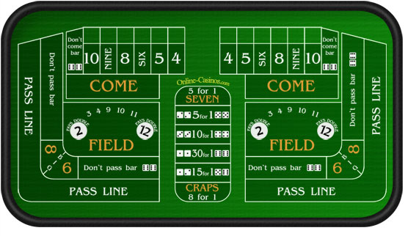
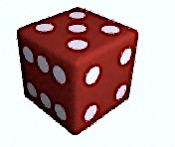
Shooting Craps
In the game of craps, if the player’s first roll of two dice totals 7 or 11, the player wins. What is the probability that a player will win on the first roll?

Slide 35
Let’s Try This Sample Space
In the game of craps, if the player’s first roll of two dice totals 7 or 11, the player wins. What is the probability that a player will win on the first roll?
 | 1 | 2 | 3 | 4 | 5 | 6
1
2
3
4
5
6

Slide 36
Choosing a Sample Space with Equally likely Outcomes
In the game of craps, if the player’s first roll of two dice totals 7 or 11, the player wins. What is the probability that a player will win on the first roll?
 | 1 | 2 | 3 | 4 | 5 | 6
1 |  | 3
2 | 3
3
4
5
6

Slide 37
Choosing a Sample Space with Equally likely Outcomes
In the game of craps, if the player’s first roll of two dice totals 7 or 11, the player wins. What is the probability that a player will win on the first roll?
 | 1 | 2 | 3 | 4 | 5 | 6
1 | 2 | 3 | 4 | 5 | 6 | 7
2 | 3 | 4 | 5 | 6 | 7 | 8
3 | 4 | 5 | 6 | 7 | 8 | 9
4 | 5 | 6 | 7 | 8 | 9 | 10
5 | 6 | 7 | 8 | 9 | 10 | 11
6 | 7 | 8 | 9 | 10 | 11 | 12

Slide 38
Determining the Event
In the game of craps, if the player’s first roll of two dice totals 7 or 11, the player wins. What is the probability that a player will win on the first roll?
 | 1 | 2 | 3 | 4 | 5 | 6
1 | 2 | 3 | 4 | 5 | 6 | 7
2 | 3 | 4 | 5 | 6 | 7 | 8
3 | 4 | 5 | 6 | 7 | 8 | 9
4 | 5 | 6 | 7 | 8 | 9 | 10
5 | 6 | 7 | 8 | 9 | 10 | 11
6 | 7 | 8 | 9 | 10 | 11 | 12

Slide 39
Computing the Probability
In the game of craps, if the player’s first roll of two dice totals 7 or 11, the player wins. What is the probability that a player will win on the first roll?
The probability is given by:
P(win on first roll) = 8/36 or 22.22%

Slide 40
Why Study For a Quiz?
Suppose you are taking a 3 question true/false quiz. The first question is worth 3 points, the second 5 points, and the third 7 points.
You have no idea what the correct answers are, so you decided to randomly guess for each question.
What is the probability that you will pass the quiz?

Slide 41
This is why….
Q1: 3 points
Q2: 5 points
Q3: 7 points
Points %
15 | 100%
8 | 53%
10 | 67%
3 | 20%
12 | 80%
5 | 33%
7 | 47%
0 | 0%
C
C
C
I
I
C
I
I
C
I
C
I
C
I

Slide 42
This is why….
Q1: 3 points
Q2: 5 points
Q3: 7 points
Points %
15 | 100%
8 | 53%
10 | 67%
3 | 20%
12 | 80%
5 | 33%
7 | 47%
0 | 0%
C
C
C
I
I
C
I
I
C
I
C
I
C
I

Slide 43
Why Study For a Quiz?
Suppose you are taking a 3 question true/false quiz. The first question is worth 3 points, the second 5 points, and the third 7 points.
You have no idea what the correct answers are, so you decided to randomly guess for each question.
What is the probability that you will pass the quiz?
P(pass) = 3/8 = 37.5%

Slide 44
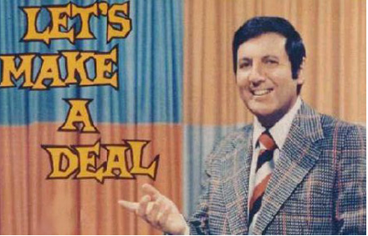
Let’s Make a Deal
Suppose you're on Let’s Make
a Deal, and you're given the
choice of three doors.
Behind one door is a car and the
other two have goats.
You pick a door, and the host opens another door revealing a goat.
He then says to you, "Do you want to stay with your door, or switch to the other unopened door?"
What will you do?

Slide 45
Let’s Try This Deal!

Slide 46
What Is the Deal?
Are you more likely to win the car if you switch?
This is usually called the Monty Hall Problem, in honor of the original host of Let’s Make a Deal.

Slide 47
The Monty Hall Backlash
Marilyn vos Savant is perhaps most famous for an article she wrote for Parade Magazine in 1990 when she posed the Monty Hall problems and stated it was better to switch.
She received around 10,000 letters (about 1000 PhD’s), and 92% or the responders stated she was wrong

Slide 48
The Highlights
George Mason University: “You blew it. As a professional mathematician, I’m very concerned with the general public’s lack of mathematical skills. Please help by confessing your error.”
Dickinson State University: “I am in shock that after being corrected by at least three mathematicians, you still do not see your mistake.”
Georgetown: “How many irate mathematicians are needed to change your mind?”
U.S. Army Research Institute: “If all those PhDs are wrong, the country would be in serious trouble.”

Slide 49
First Strategy: We Do Not Switch
Door Chosen
Prize Behind Door
Result
1
1
2
3
2
1
3
1
2
3
2
3
Car
Goat
Goat
Goat
Car
Goat
Goat
Goat
Car

Slide 50
First Strategy: We Do Not Switch
Door Chosen
Prize Behind Door
Result
1
1
2
3
2
1
3
1
2
3
2
3
Car
Goat
Goat
Goat
Car
Goat
Goat
Goat
Car

Slide 51
Conclusion For First Strategy
P(Car) = 3/9 or 33.33%

Slide 52
Second Strategy: We Do Switch
Door Chosen
Prize Behind Door
Result
1
1
2
3
2
1
3
1
2
3
2
3
Goat
Car
Car
Car
Goat
Car
Car
Car
Goat

Slide 53
Second Strategy: We Do Switch
Door Chosen
Prize Behind Door
Result
1
1
2
3
2
1
3
1
2
3
2
3
Goat
Car
Car
Car
Goat
Car
Car
Car
Goat

Slide 54
Conclusion For Second Strategy
P(Car) = 6/9 or 66.67%

Slide 55
Conclusion
Marilyn vos Savant was right! It is better to switch, and we can see this from looking at the sample space.

Slide 56
The Product Rule of Probability
If two possible events, A and B, are independent, then the probability that both A and B will occur is equal to the product of their individual probabilities.
That is, P(A and B) = P(A) P(B). But remember, the events need to be independent of each other.

Slide 57
Why Multiply?
Suppose you decide to make a pack of trading cards of those 100 guys from the Internet dating service.
On the back of each card you list certain data about the men
Honest (yes or no)
Attractive (yes or no)
Suppose that 1 in 10 of the prospective soul mates rates a yes in each case.
How many pass the test on both counts?

Slide 58
Why Multiply?
1 in 10 cards lists a yes under honest, so you can expect 10 of the 100 cards will qualify.

Slide 59
Why Multiply?
1 in 10 cards lists a yes under honest, so you can expect 10 of the 100 cards will qualify.
Of those 10, 1 in 10 lists yes under attractive, so you can expect to be left with 1 card.

Slide 60
Why Multiply?
1 in 10 cards lists a yes under honest, so you can expect 10 of the 100 cards will qualify.
Of those 10, 1 in 10 lists yes under attractive, so you can expect to be left with 1 card.
Each pass cuts the possibilities down by 1/10. That’s why we multiply.
If you have more requirements than just honest and attractive, you have to keep multiplying . . .

Slide 61
Independent Events
Events A and B in a sample space are independent if the probability of Event B occurring is the same whether or not Event A occurs.

Slide 62
Independent Events
Events A and B in a sample space are independent if the probability of Event B occurring is the same whether or not Event A occurs.
Example: A fair coin is tossed, and the sample space is S = {HH, HT, TH, TT}
Event A = first toss is a head
Event B = second toss is a head

Slide 63
Are the Events Independent?
Event A is “It will rain tomorrow in Chambersburg,” and event B is “It will rain tomorrow in Shippensburg.”

Slide 64
Are the Events Independent?
Event A is “It will rain tomorrow in Chambersburg,” and event B is “It will rain tomorrow in Shippensburg.”
From a deck of playing cards two cards are drawn. Event A is the first card’s suit is red, and event B is the second card’s suit is red.

Slide 65
Are the Events Independent?
You randomly pull out one pair of socks and one shirt from a drawer that has 10 pairs of socks, 6 of which are white; and 7 shirts, 3 of which are white. Event A is drawing a pair of white socks, and Event B is drawing a white shirt.

Slide 66
Are the Events Independent?
You randomly pull out one pair of socks and one shirt from a drawer that has 10 pairs of socks, 6 of which are white; and 7 shirts, 3 of which are white. Event A is drawing a pair of white socks, and Event B is drawing a white shirt.
What is the probability of choosing a pair of
white socks and a white shirt?

Slide 67
The Sum Rule of Probability
If two possible events, A and B, are mutually exclusive, then the probability either A or B will occur is equal to the sum of their individual probabilities.
That is, P(A or B) = P(A) + P(B). But remember, the events need to be mutually exclusive

Slide 68
Why Add?
Remember the pack of trading cards of those 100 guys from the Internet dating service?
On the back of each card you list certain data about the men
Shoulder-length hair (yes or no)
Bald (yes or no)
Suppose that 1 in 10 of the prospective soul mates rates a yes in each case.
How many pass the test on one or the other?

Slide 69
Why Add?
1 in 10 cards lists a yes under shoulder-length hair, so you can expect 10 of the 100 cards will qualify.

Slide 70
Why Add?
1 in 10 cards lists a yes under shoulder-length hair, so you can expect 10 of the 100 cards will qualify.
Also, 1 in 10 lists yes under bald, so you can expect 10 of the 100 cards will qualify.

Slide 71
Why Add?
1 in 10 cards lists a yes under shoulder-length hair, so you can expect 10 of the 100 cards will qualify.
Also, 1 in 10 lists yes under bald, so you can expect 10 of the 100 cards will qualify.
Each pass adds 10 new, distinct possibilities. That’s why we add.
If we have more options for hairstyles, you just keep adding…

Slide 72
Adding up to 1
Lifetime odds of dying from . . .
Fireworks discharge: 1 in 652,046
Flood: 1 in 558,896
Dog bite: 1 in 144,189
Lightning: 1 in 134,906
Legal execution: 1 in 111,179
Earthquake: 1 in 97,807
Bees: 1 in 79,842
Storm: 1 in 29,196
Natural heat: 1 in 13,217
Electric current: 1 in 12,420
Air and space incidents: 1 in 7,178
Accidental firearm discharge: 1 in 6,609
Pedalcyclist crash: 1 in 4,381
Fire: 1 in 1,344
Motorcycle crash: 1 in 761
Pedestrian accident: 1 in 701
Car accident: 1 in 368
Assault by firearm: 1 in 321
Falls: 1 in 163
Poisoning: 1 in 126
Self-harm: 1 in 109
Stroke: 1 in 29
Cancer: 1 in 7
Heart disease: 1 in 6

Slide 73
Adding up to 1
Lifetime odds of dying from . . .
Fireworks discharge: 1 in 652,046
Flood: 1 in 558,896
Dog bite: 1 in 144,189
Lightning: 1 in 134,906
Legal execution: 1 in 111,179
Earthquake: 1 in 97,807
Bees: 1 in 79,842
Storm: 1 in 29,196
Natural heat: 1 in 13,217
Electric current: 1 in 12,420
Air and space incidents: 1 in 7,178
Accidental firearm discharge: 1 in 6,609
Pedalcyclist crash: 1 in 4,381
Fire: 1 in 1,344
Motorcycle crash: 1 in 761
Pedestrian accident: 1 in 701
Car accident: 1 in 368
Assault by firearm: 1 in 321
Falls: 1 in 163
Poisoning: 1 in 126
Self-harm: 1 in 109
Stroke: 1 in 29
Cancer: 1 in 7
Heart disease: 1 in 6
Lifetime odds of dying from something: 1 in 1

Slide 74
Mutually Exclusive Events
Events A and B in a sample space are mutually exclusive if both events cannot occur at the same time.

Slide 75
Mutually Exclusive Events
Events A and B in a sample space are mutually exclusive if both events cannot occur at the same time.
Example: Two fair coins are tossed, and the sample space is S = {HH, HT, TH, TT}
Event A = the first coin lands on heads
Event B = the first coin lands on tails

Slide 76
Are the Events Mutually Exclusive?
Event A is “It will snow tomorrow in Shippensburg,” and event B is “Classes at Ship will be cancelled tomorrow.”

Slide 77
Are the Events Mutually Exclusive?
Event A is “It will snow tomorrow in Shippensburg,” and event B is “Classes at Ship will be cancelled tomorrow.”
From a deck of playing cards two cards are drawn. Event A is the first card’s suit is red, and event B is the second card’s suit is red.

Slide 78
Are the Events Independent?
You randomly pull out one pair of socks and one shirt from a drawer that has 10 pairs of socks, 6 of which are white; and 7 shirts, 3 of which are white and 2 of which are blue. Event A is drawing a white shirt, and Event B is drawing a blue shirt.
What is the probability of choosing either a
white shirt or a blue shirt?

