Slide 1
ASSURANCE OF LEARNING

Slide 2
current areas of assessment
goates.2011
WRITTEN COMM
(MKT 305)
ORAL COMM
(MGT 497)
TEAMWORK
(MGT 305)
KNOWLEDGE
computers & tech
(ISM 142)
statistics
(SCM 200)
finance
(FIN 311)
accounting
(ACC 200 & ACC 201)
marketing
(MKT 305)
supply chain
(SCM 330)
ethics
(MGT 447)
management
(MGT 305)
senior exit exam

Slide 3
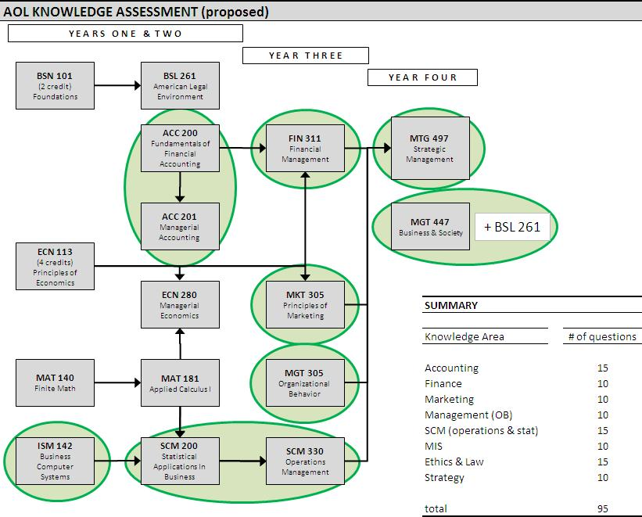
current areas of assessment
goates.2011
KNOWLEDGE
senior exit exam

Slide 4
current areas of assessment
goates.2011
KNOWLEDGE
Senior Knowledge Test – Preliminary Results
senior exit exam
mean 49.85 (55%)
median 50 (56%)
max 72 (80%)
min 20 (22%)
n = 110; 90 questions

